Slide 1
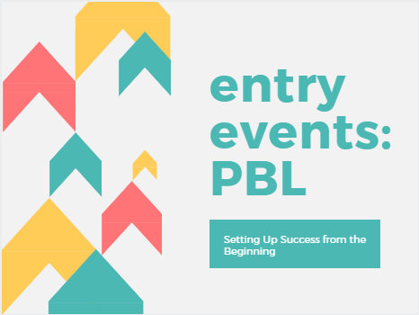
Using STEM for Entry Events in PBL
Chris
Bellagamba
AA/STEM
Kat Fowler
METI

Slide 2
Project Based Learning
Project Based Learning (PBL) is an authentic and engaging approach for students to learn the standards in a meaningful way that provides real-world relevance for learning. PBL is student centered and learning happens throughout the entire process. PBL promotes life-long learning, critical thinking, and creates students that are college and career ready.

Slide 3
What’s the PURPOSE of a STEM Education?
As a group, come up with the one word that best described STEM.
Work together to write the word. You can only touch the string.

Slide 4
What’s the
PURPOSE
of an
ENTRY
EVENT?

Slide 5
Graphic from www.p21.org

Slide 6
Entry Event: Balloon Towers
Build the tallest free standing balloon tower in 10 minutes.
Clarifications:
-Must stand after time is called
-Everyone has the same number of balloons

Slide 7
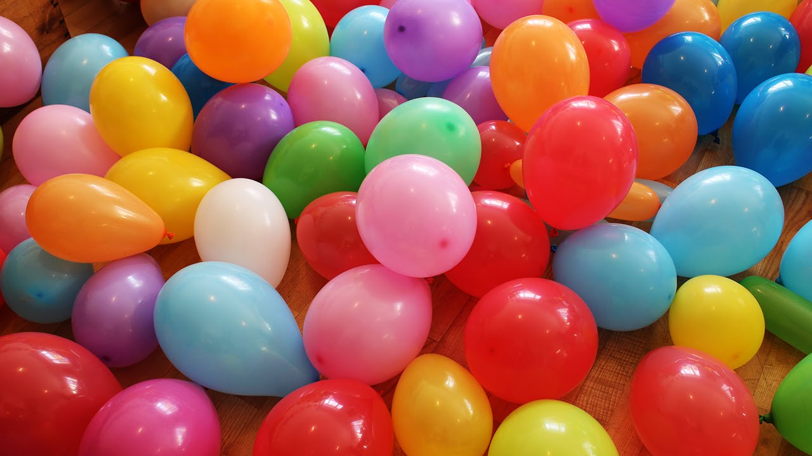
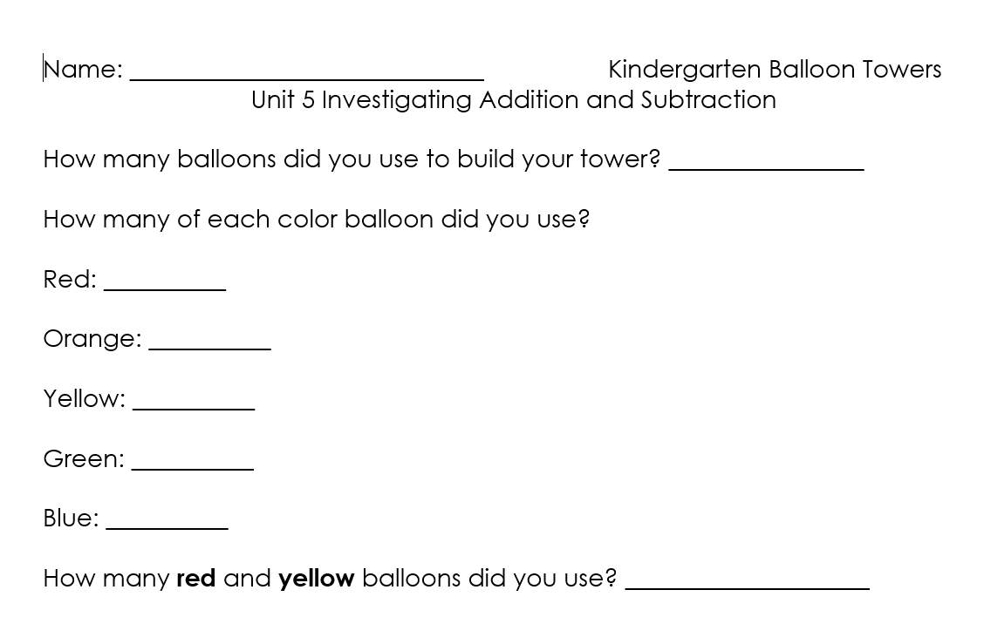
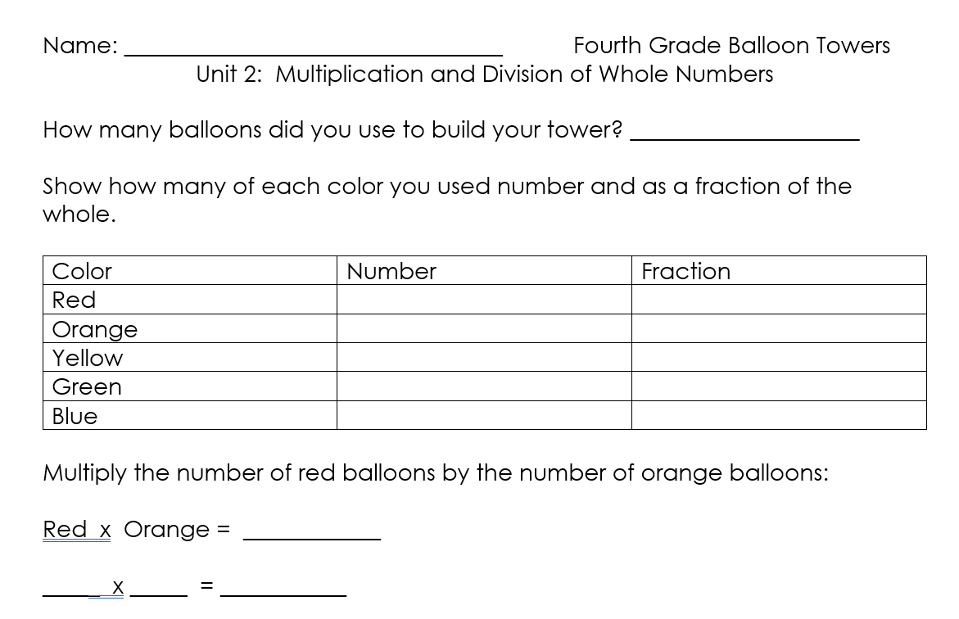
Balloon Towers

Slide 8
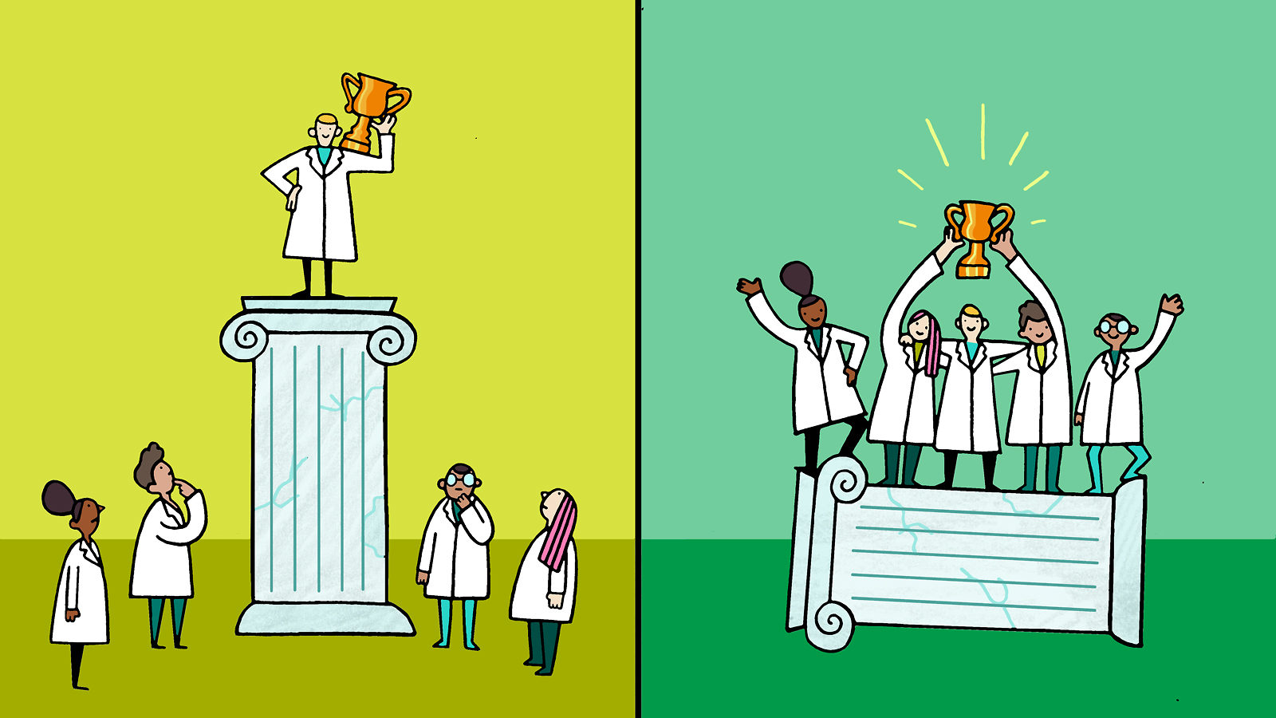
Building Your Classroom Community
https://www.symmetrymagazine.org/article/rewiring-stem-education

Slide 9
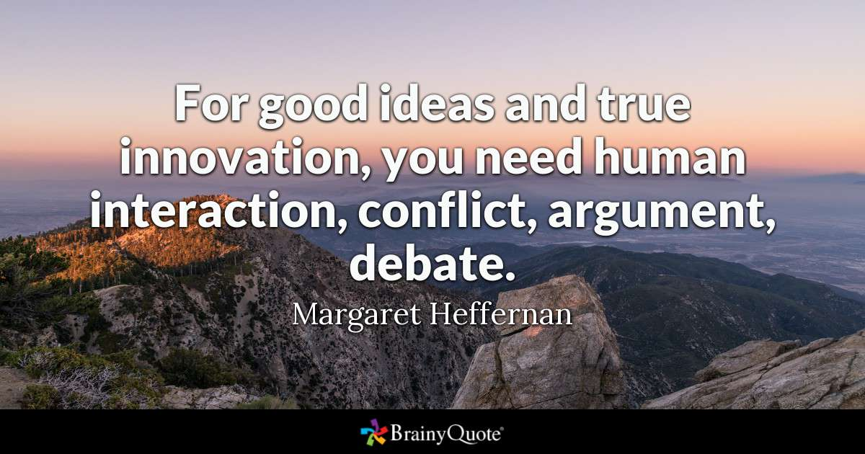

Slide 10
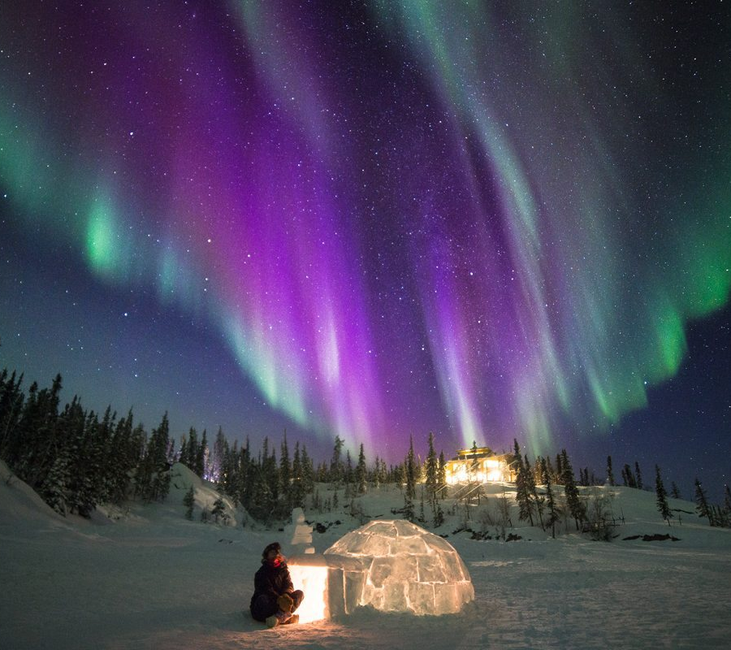
Google Expeditions
Aurora Borealis – Guided Exploration
4th Grade GSE- Light and Color

Slide 11
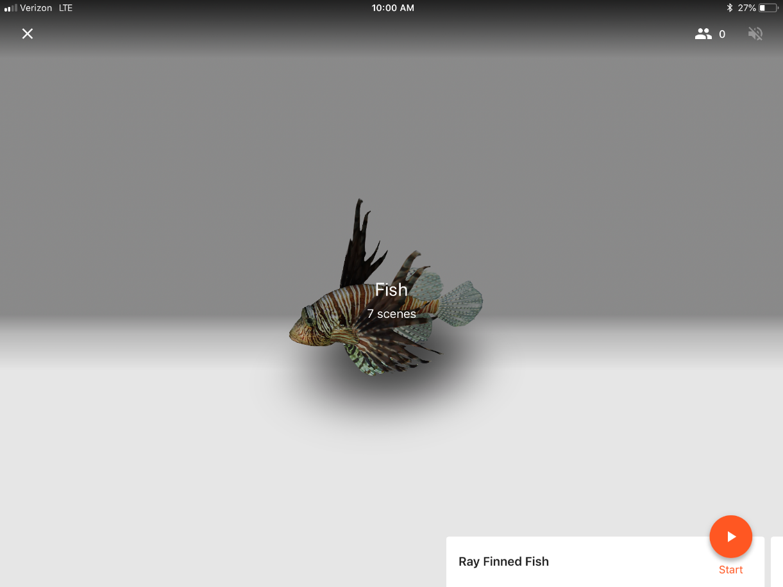
3-d Images- Markers

Slide 12
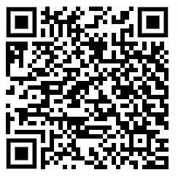
Google Expeditions Linked to Standards
K-Careers/Community Helpers
1- National Parks
2-How People Use Natural Resources
3- Regions/Landscapes
4-American Expands West
5- Grand Canyon, Ellis Island

Slide 13
Entry Event:
Push and Pull
With Spheros and Legos

Slide 14
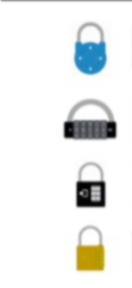
Break Out: Goldilocks and the Just Right Planet

Slide 15
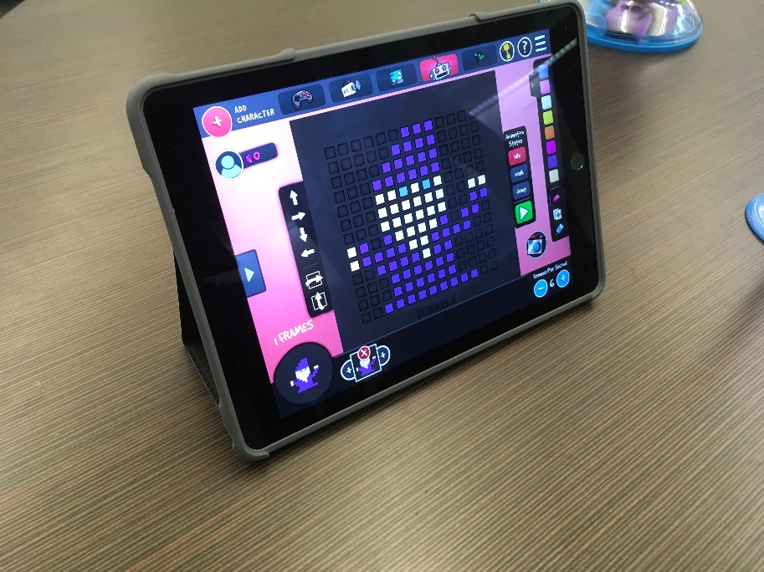
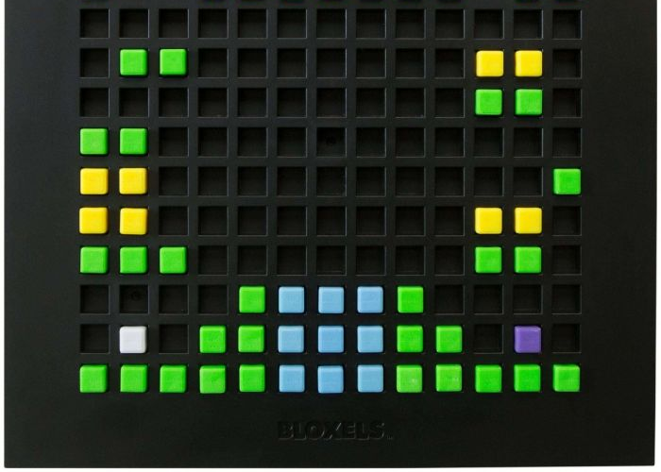
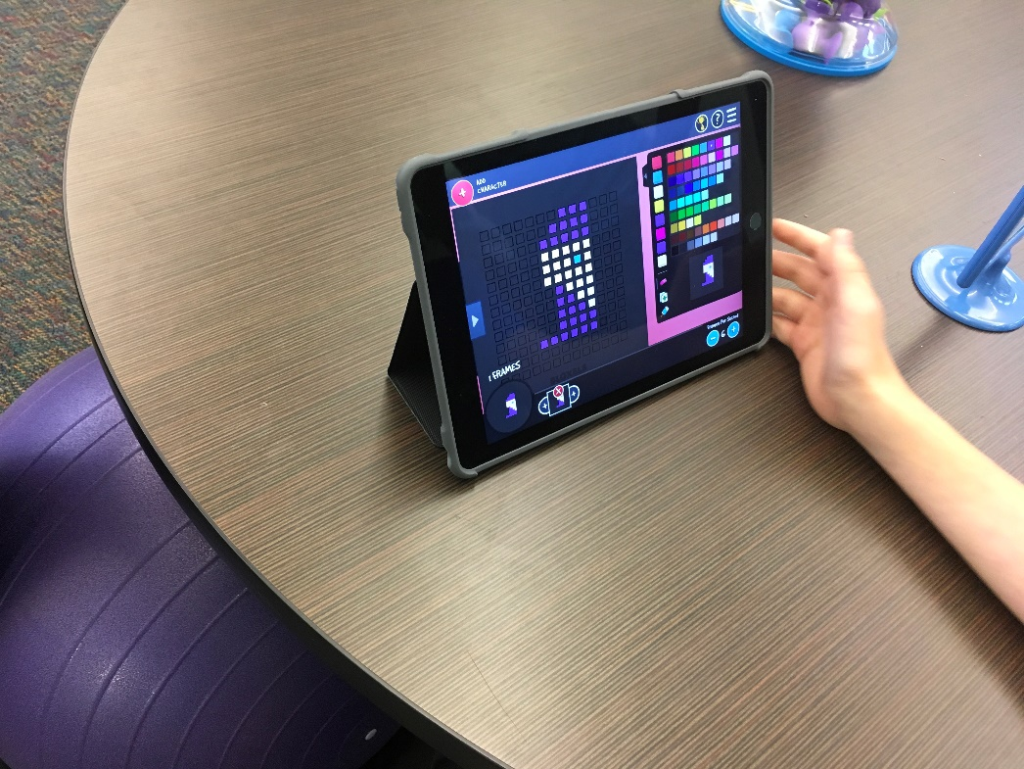
Bloxels- Creating Fairy Tales

Slide 17
Let’s Dive into some more examples
Examples of PBL’s per grade level are spread throughout the room

